Slide 1
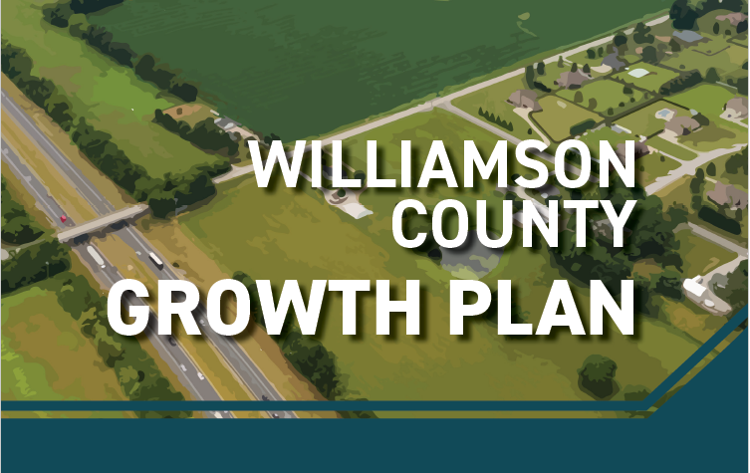
Breakfast with the Mayors Kristi Dunlap Ransom
July 30, 2024 County Attorney for Planning & Environment

Slide 2
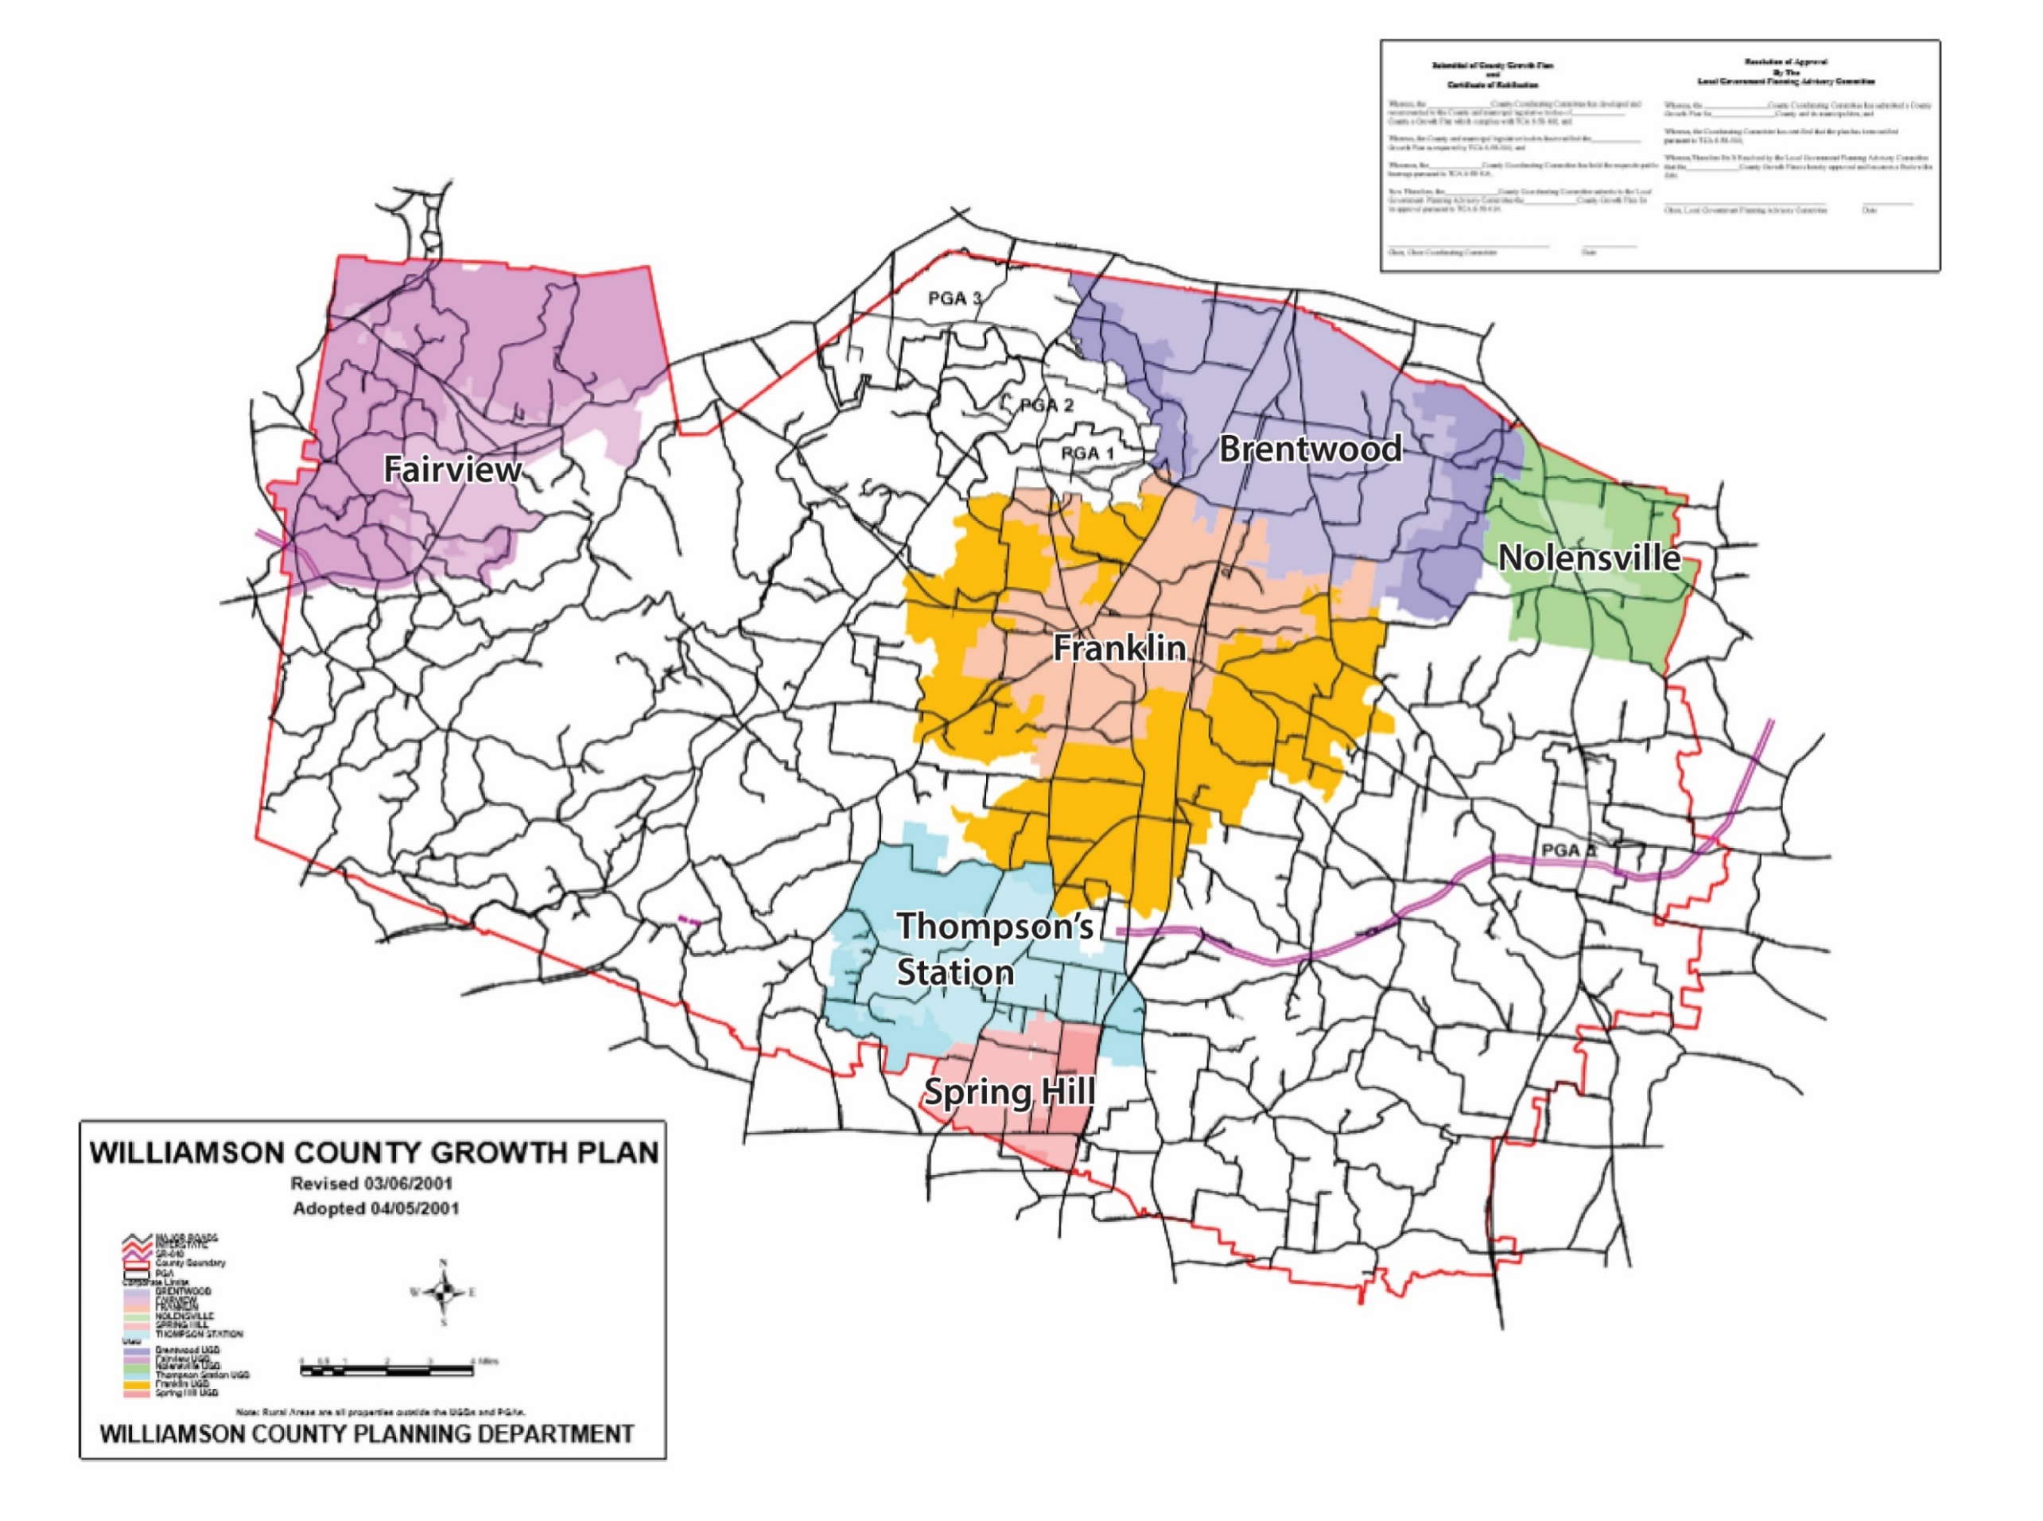
Williamson County Growth Plan
County-wide plan that establishes:
  Urban Growth Boundaries (UGB’s) around municipalities
  Planned Growth Areas (PGA’s) outside of UGB’s
  Rural Areas
Mandated by State Legislature
Current growth boundaries adopted in 2001

Slide 3
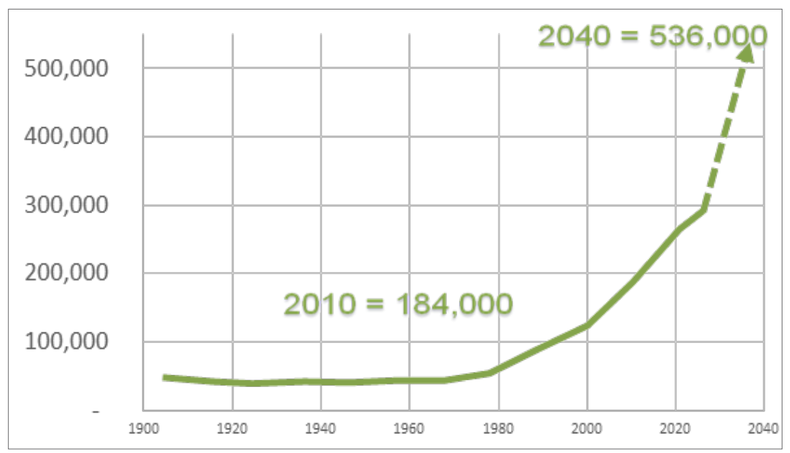
Population Breakdown
RESEARCH & ANALYSIS
248,000
2020 Williamson County-wide Population
288,000
Additional people by 2040
536,000
Williamson County Forecast 2040
2020=248,000
Exponential increase from 1980 - 2017
Data Source: 2018 Williamson County Trends Report; US Census Bureau 2017 ACS

Slide 4
Why Update the Growth Plan?
It had been more than 20 years since it was created, and an update was overdue
Growth patterns have changed, along with projections for where infrastructure (namely sewer) can and should be provided
The County’s Comprehensive Plan (2020) calls for a re-evaluation of these areas

Slide 5
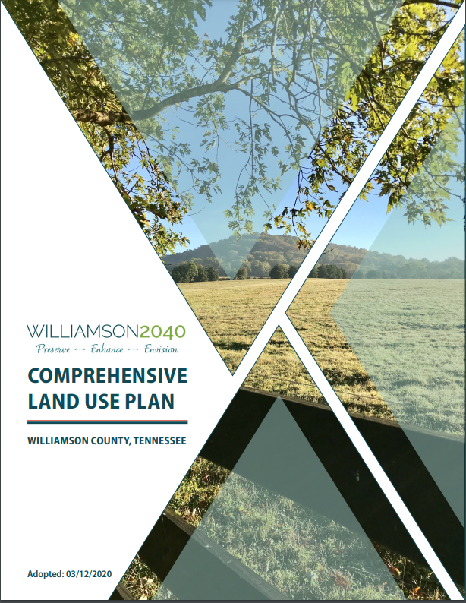
Williamson County
Comprehensive Plan

Slide 6
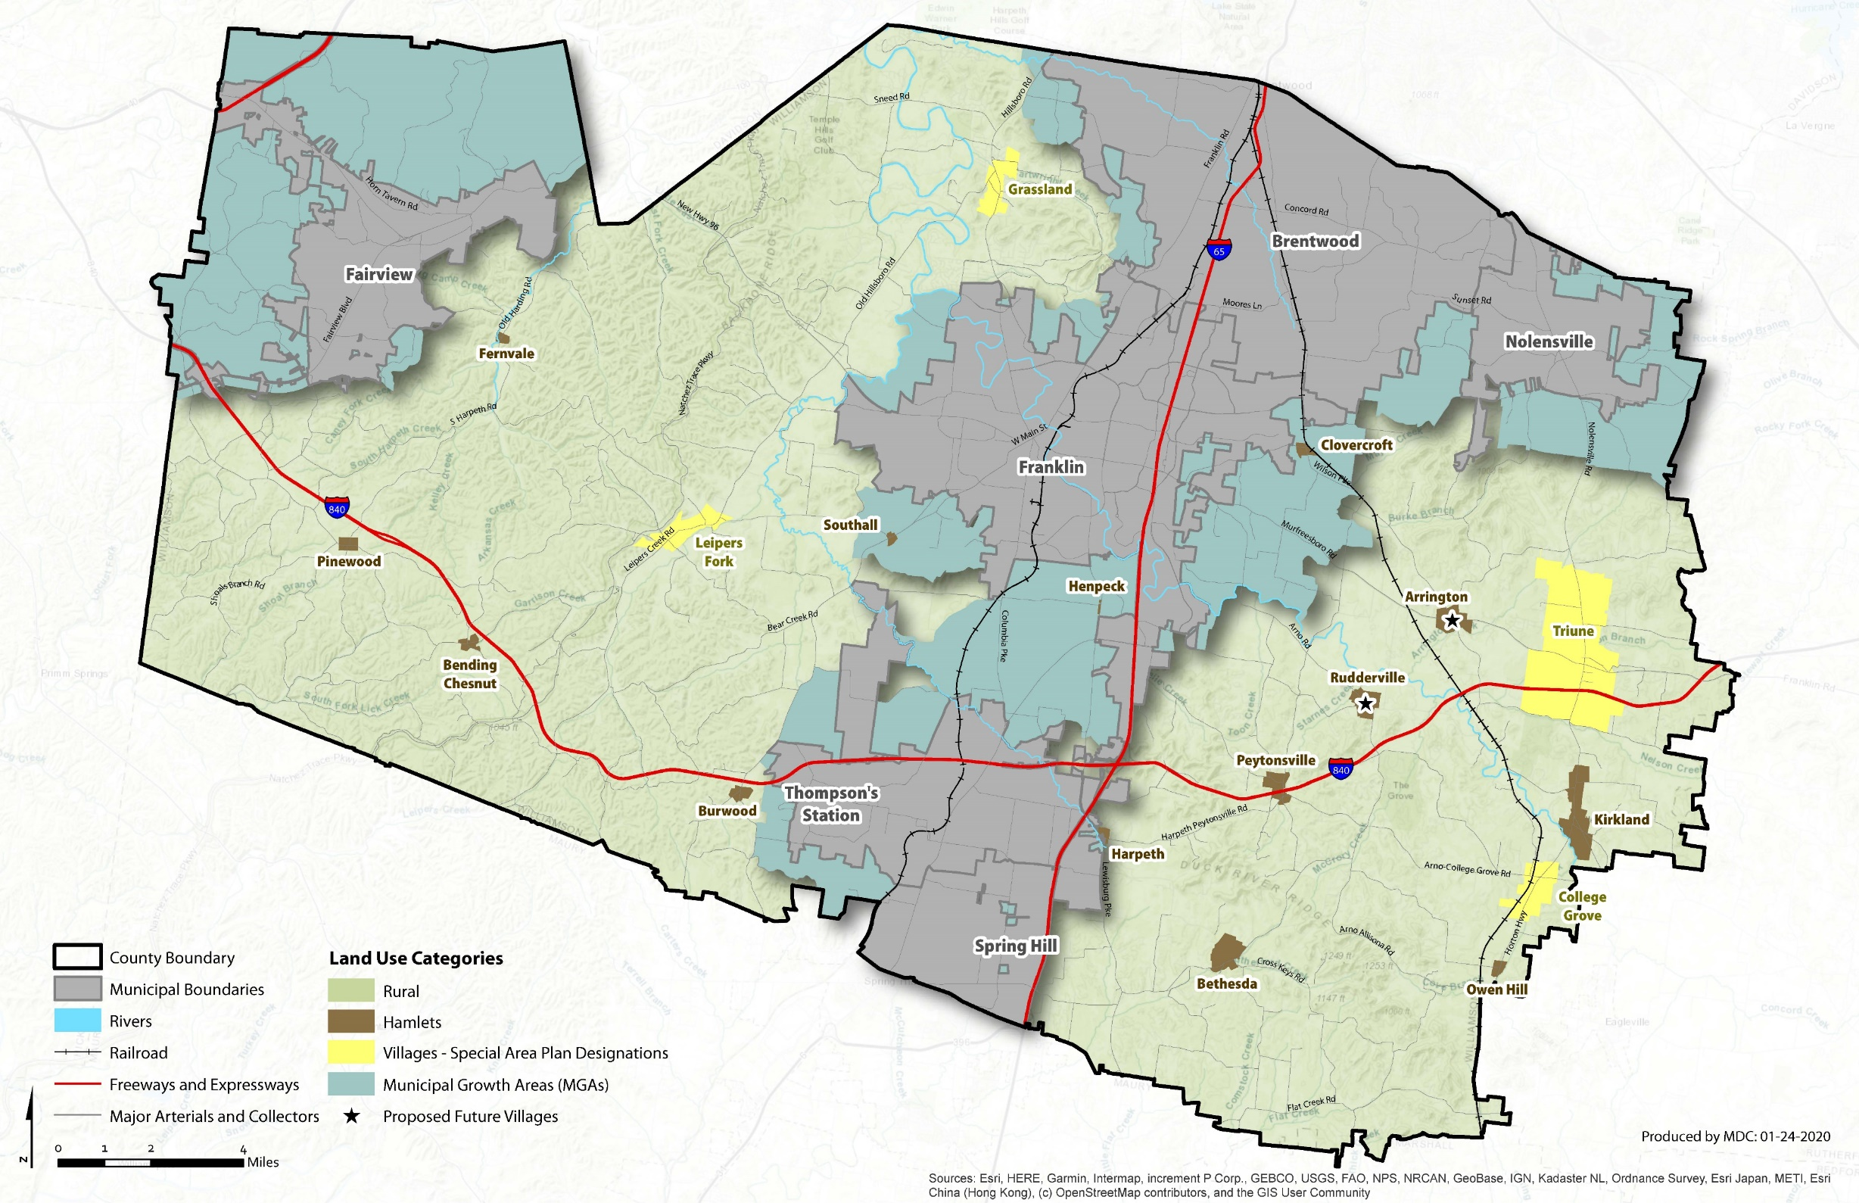
Williamson County
Comprehensive Plan
Reduce allowable residential densities outside of UGB’s, Villages and Hamlets
Engage in collaborative regional growth management planning

Slide 7
Regional Growth Management
Municipalities and the County evaluated where growth should occur based upon
  Population projections
  Available land
  The provision of infrastructure
  Other factors
Collaborative Process Occurred Prior to Formal Growth Plan Update Process

Slide 8
Regional Growth Management
Advisory Group consisting of representatives from each jurisdiction and other stakeholders
Planners Group
Technical Advisors
Facilitator
Contributors:

Slide 9
Regional Growth Management
Ensure that the system of UGB’s, PGA’s and Rural Areas function as optimally as possible
  Create and implement interim policies related to development within UGB’s occurring prior to annexation
  Municipalities will not annex outside of UGB’s
Continue the process of collaborative, multi-jurisdictional planning on an ongoing basis
  Revisit the Growth Plan at least every 5 years
  Growth Plan Implementation Committee
  Multi-jurisdictional entity focusing on transportation planning
Goals and Strategies:

Slide 10
Growth Plan Update
Because each jurisdiction had identified changes to their desired growth patterns during the Growth Management Planning phase, there was a collective desire to pursue an amendment to the official Williamson County Growth Plan
The Formal Process to update the Growth Plan was initiated in May of 2023.

Slide 11
What is contained in the Growth Plan?
Map:
Urban Growth Boundaries – Areas identified by Municipalities for projected growth
Planned Growth Areas – Areas identified by the County for projected growth based
Rural Areas – Areas of the unincorporated County not contained within a UGB or PGA
Other Provisions: Implementation Goals and Strategies

Slide 12
PROCESS
Establishment of Coordinating Committee
Individual Jurisdiction Public Hearings
Jurisdiction Presentations to Coordinating Committee
Preparation of Draft Revised Growth Plan
Coordinating Committee Public Hearings
Refinement and Approval (by Coordinating Committee) of recommended Plan
Transmittal of Recommended Plan to Jurisdictions for Consideration

Slide 13
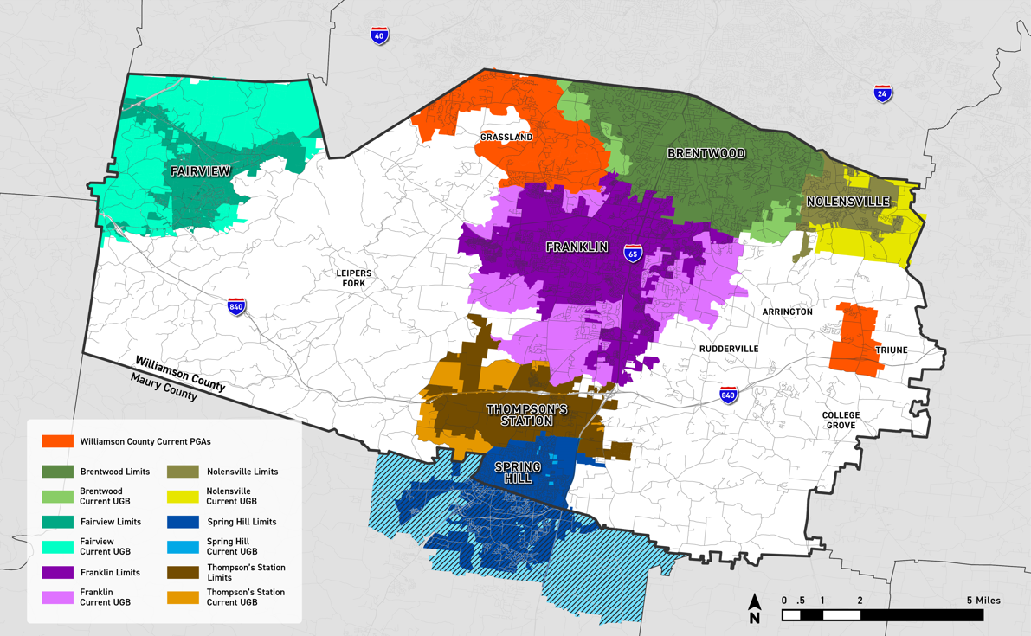
2001 Growth Plan Map

Slide 14
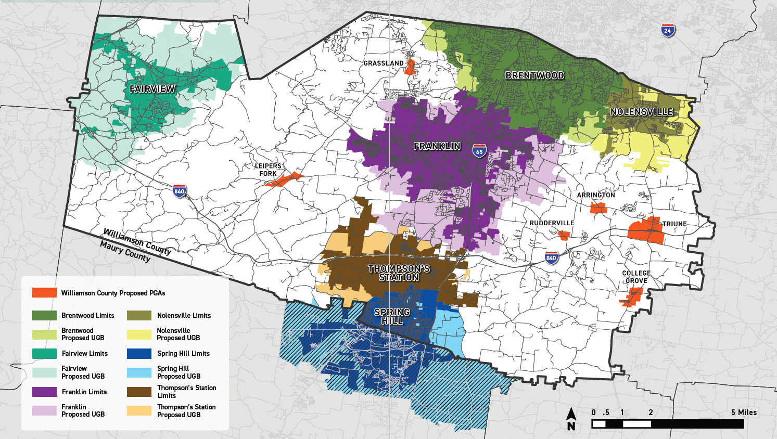
Approved Growth Plan Map

Slide 15
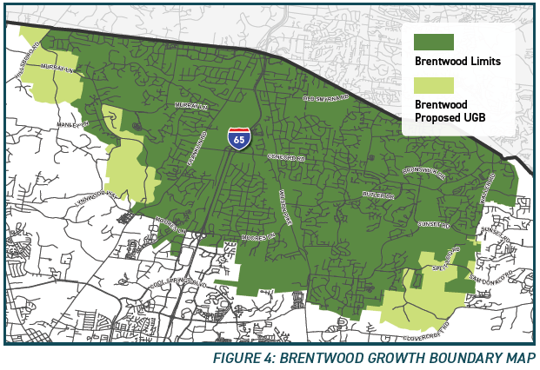

Slide 16
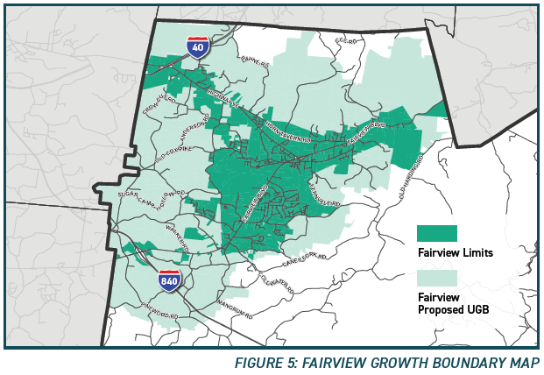

Slide 17
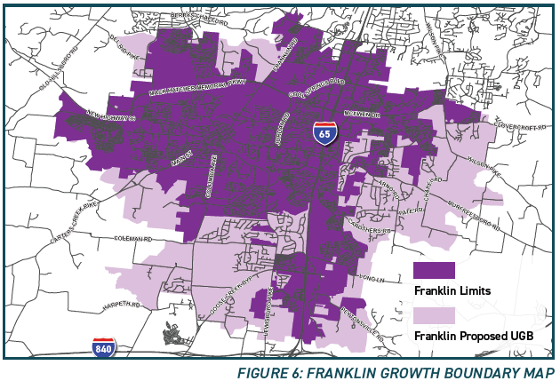

Slide 18
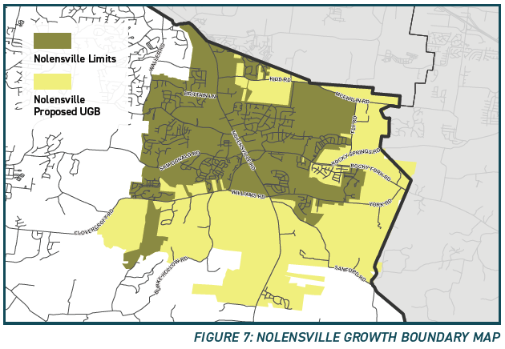

Slide 19
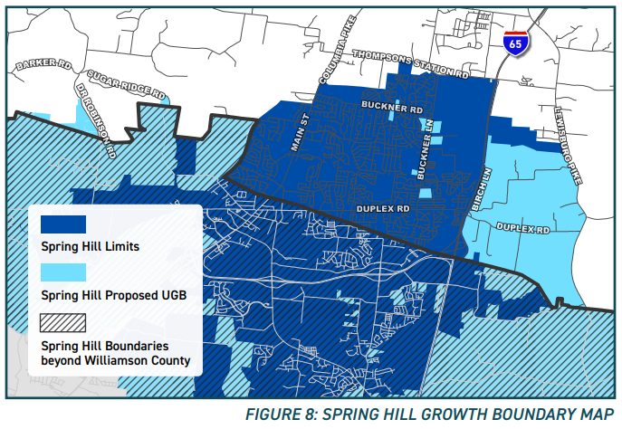

Slide 20
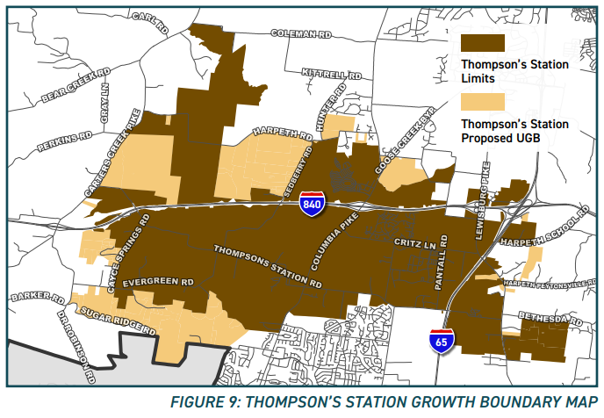

Slide 21
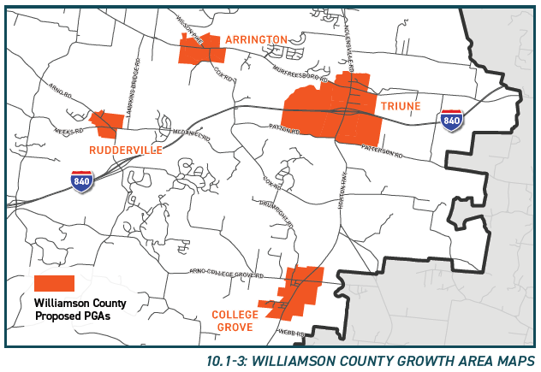

Slide 22
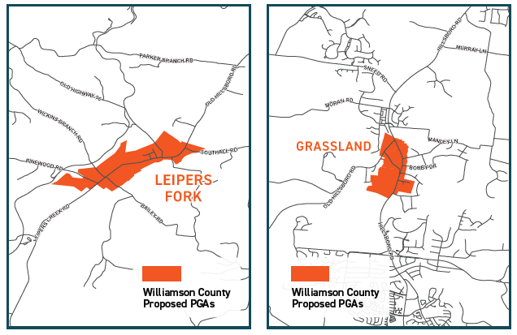

Slide 23
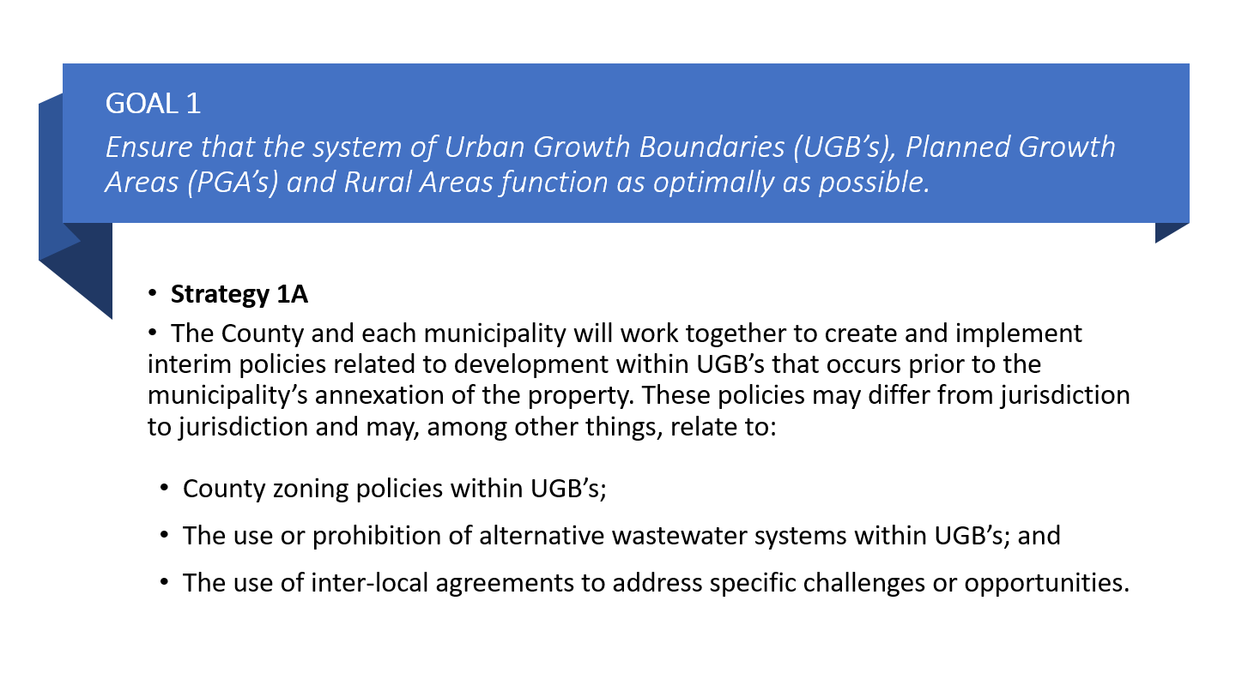
GOAL 1
Ensure that the system of Urban Growth Boundaries (UGB’s), Planned Growth Areas (PGA’s) and Rural Areas function as optimally as possible.

Slide 24
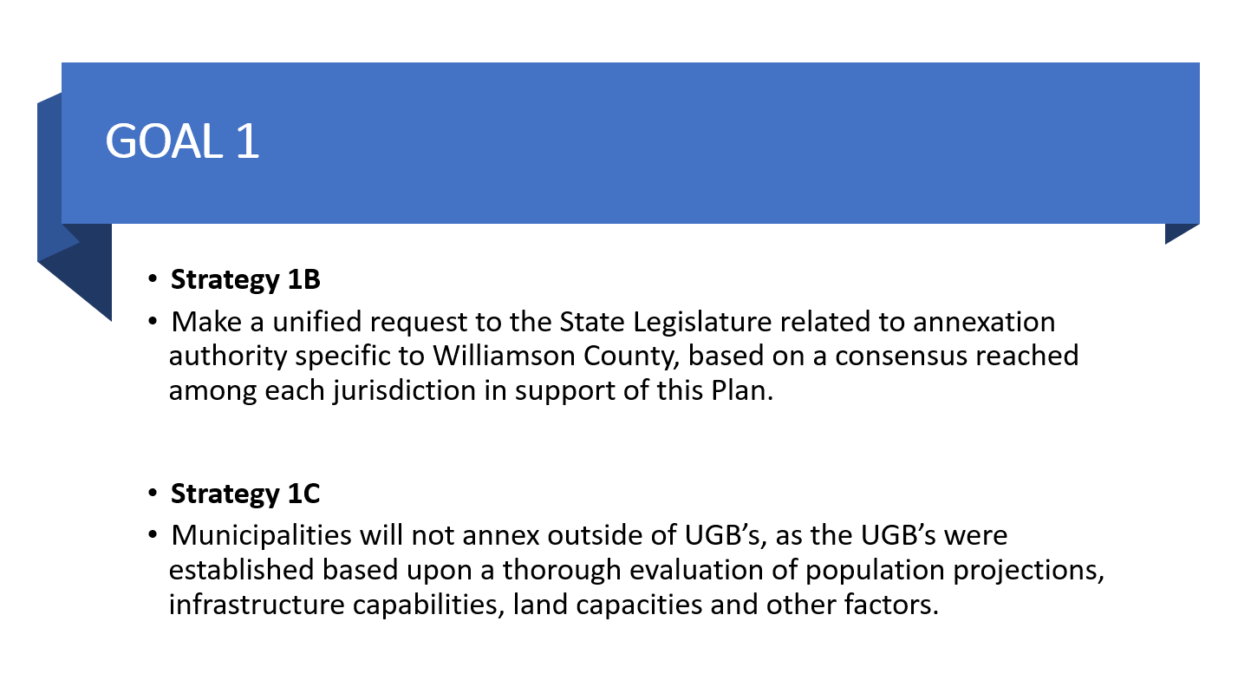

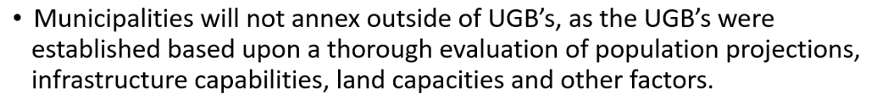

GOAL 1

Slide 25
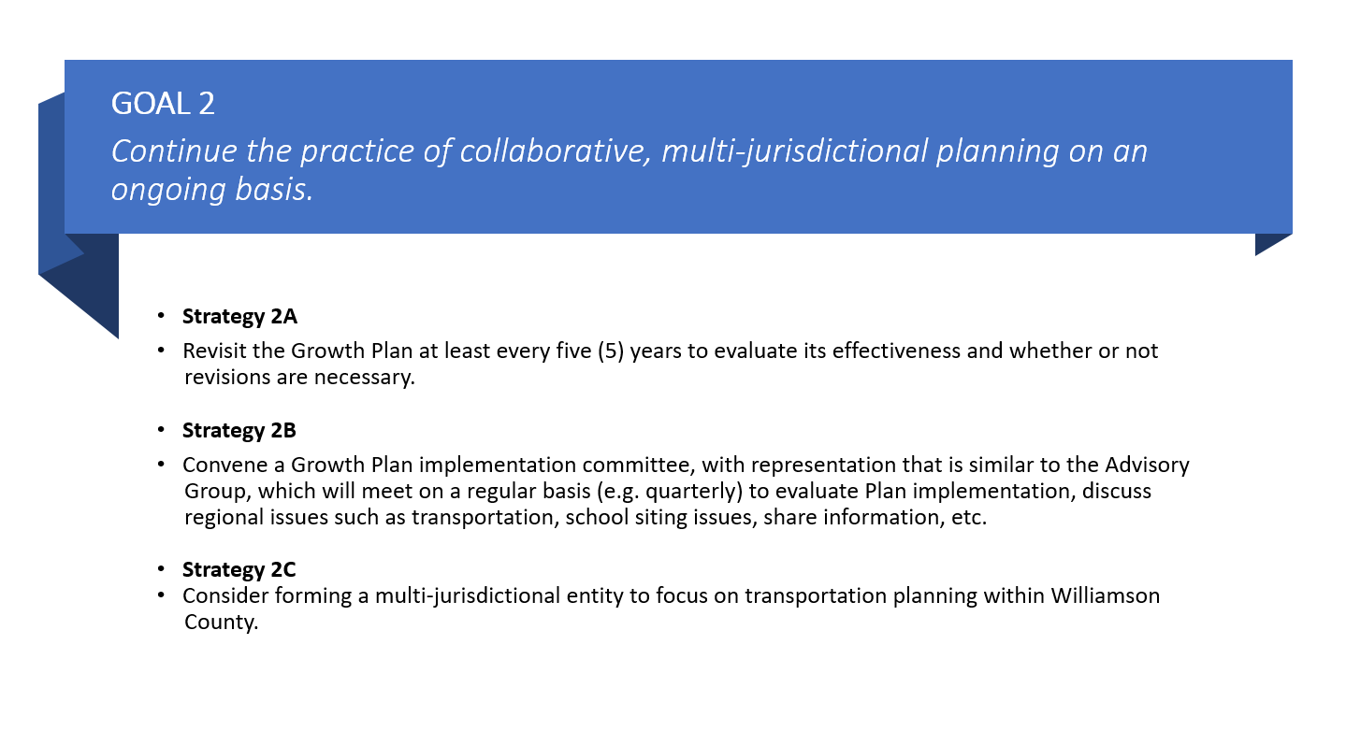
GOAL 2
Continue the practice of collaborative, multi-jurisdictional planning on an ongoing basis.

Slide 26
Interlocal Agreement
Approved by all Municipalities and the County
A tool to help implement the Goals and Strategies in the Growth Plan
Key provisions:
  No annexation outside of a UGB
  Advisory Committee – representatives of the County and Municipalities who will meet at least four times a year; informational body designed to foster communication and cooperation
  Requires the Growth Plan to be revisited in 5 years

Slide 27
Current Status of Growth Plan
All jurisdictions have approved the Growth Plan
Transmittal to the Local Government Planning Advisory Committee for approval
Record in the Register of Deeds

Slide 28
Thank You!

